Slide 1

Pension Data Analysis
Zach Buckley

Slide 2
Data Overview
^{Data Provided}
Source: US Public Plans Database
Pension Investment Returns
Contains yearly returns data for public US investment plans
Details on returns over 1, 5, 10 years and other periods
Investment consultant associated with plan provided
Pension Plan Basics
Plan level information
Details on when plan began and ended
Provides information on the state, employee type, plan type etc.
Pension Membership
Contains yearly membership data for various US investment plans
Information on total membership, active members, and beneficiaries.
Average salary and benefits provided

Slide 3
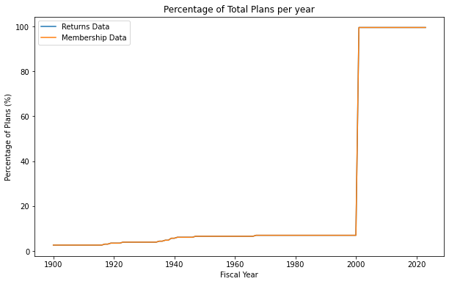
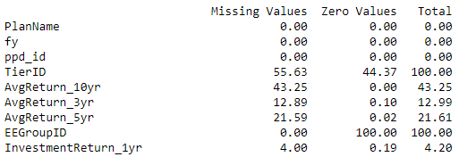
Data Cleaning and Preparation
Initial Data
returns
29 Vars, 6497 Obs
membership
33 Vars, 6470 Obs
Filter by Populated Years
returns_fIltered
29 Vars, 5244 Obs
membership_filtered
33 Vars, 5244 Obs
Remove High Missingness/ Unnecessary Variables
returns_final
9 Vars, 5244 Obs
membership_final
9 Vars, 5244 Obs
basics
13 Vars, 229 Obs
Basics_final
5 Vars, 229 Obs
Join Final Tables
returns_membership_basics
20 Vars, 5244 Obs
basics
13 Vars, 229 Obs

Slide 4
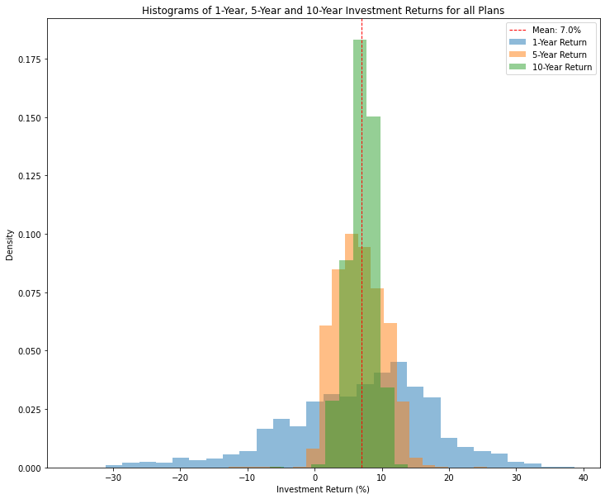
Pension Returns
Histograms show comparison of the 1, 5 and 10-year investment returns for all plans.
As expected, the volatility of returns significantly reduces over longer periods.
1-Year return
High volatility
Returns range from -30% to +40%
10-Year return
Low volatility
Returns rarely negative,
Majority of plans providing a return close to the mean of 7%.

Slide 5
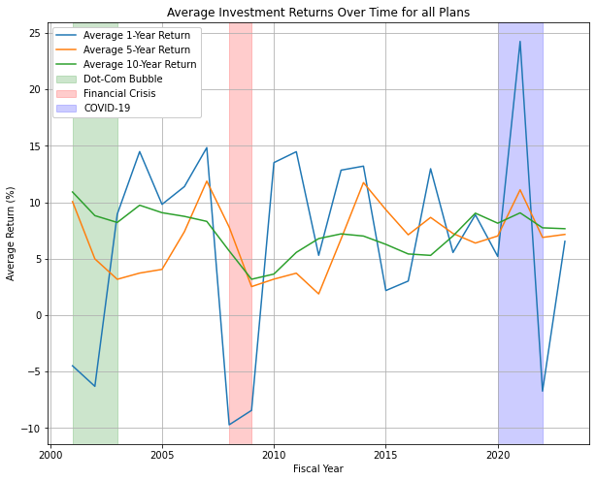
Returns Over Time
Plot shows 1, 5 and 10-year investment returns per year
10-year return shows consistent returns over time, largely ranging between 5 - 10%
Dot-Com Bubble and Financial Crisis
Significant reduction in average 1-Year return in 2001, 2002, 2003, 2008 and 2009
Mean 1-Year return dropped to -0.5% during the post-Dot Com Bubble period and to -9.1% during the financial crisis
COVID-19
Significant increase, then decrease in 1-Year returns following COVID-19
Standard deviation increased by 29% during this period when compared with the overall period

Slide 6
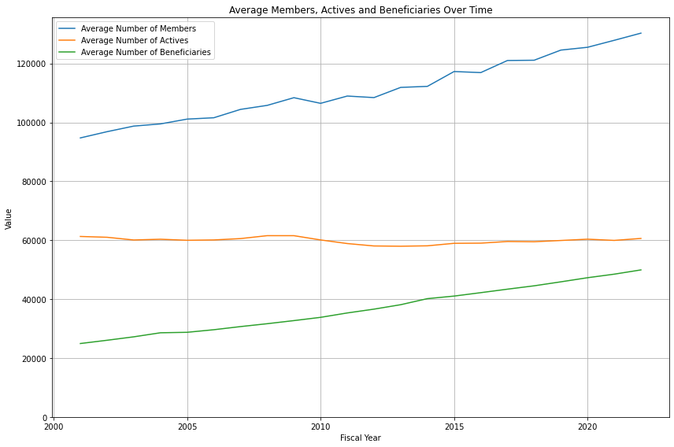
Members Over Time
Plot shows the average number of members, active members and beneficiaries over time per plan.
Average Members and Beneficiaries
Steadily increased
Could reflect an aging population - more members transitioning from active status to beneficiary status
Average Active Members
Remains relatively flat
Limited growth in the contributing workforce
Overall, could indicate a growing dependency on active contributors and a potential area of concern for the sustainability of the pension funds.

Slide 7
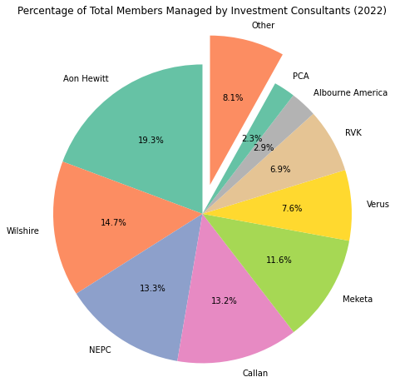
Consultants Overview
Pie chart shows the percentage of total members managed by each consultant
The top four consultants are Aon Hewitt, Wilshire, NEPC and Callan who, combined, manage over 50% of the total members

Slide 8
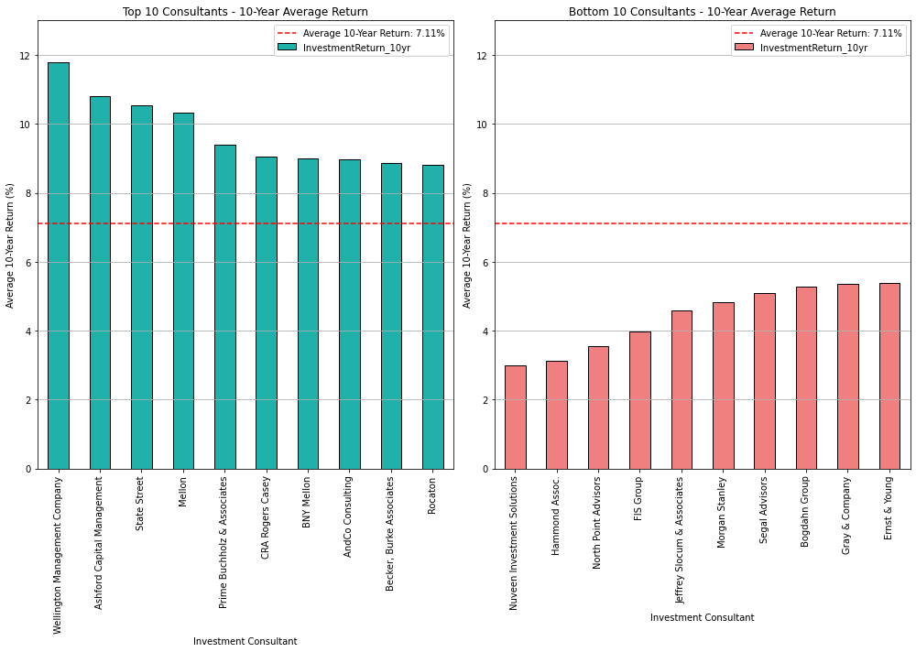
Consultant Performance
Bar charts show the top and bottom 10 performing consultants based on their average 10-year return.
Wellington Management Company provides the highest average return with 11.8%
Nuveen Investment Solutions Provides the lowest returns with 3.0%
Notably, none of these consultants are in the top consultants for total members
Consultants with more members may be more risk averse with investments, providing returns closer to the average

Slide 9
Conclusions and Potential Next Steps
Conclusions
Returns over different periods:
Economic events such as the Dot-Com Bubble, the 2008 financial crisis and COVID-19 had significant impacts on returns
Membership Trends:
Stagnant number of active members compared to beneficiaries could be cause for concern
Consultants:
The top consultants significantly outperformed the mean
The larger scale consultants were not among the top or bottom performers indicating they may adopt less risky investment strategies
Next Steps
Missingness Analysis:
Increased data missingness for 2023 could be explored
Data imputation methods could be considered
Detailed Consultant Performance Analysis:
Investigate investment strategies of top consultants
Can this performance be maintained
Cross-Country Comparison:
Compare results with pension data from other countries to understand how US performance stacks up

